Slide 1
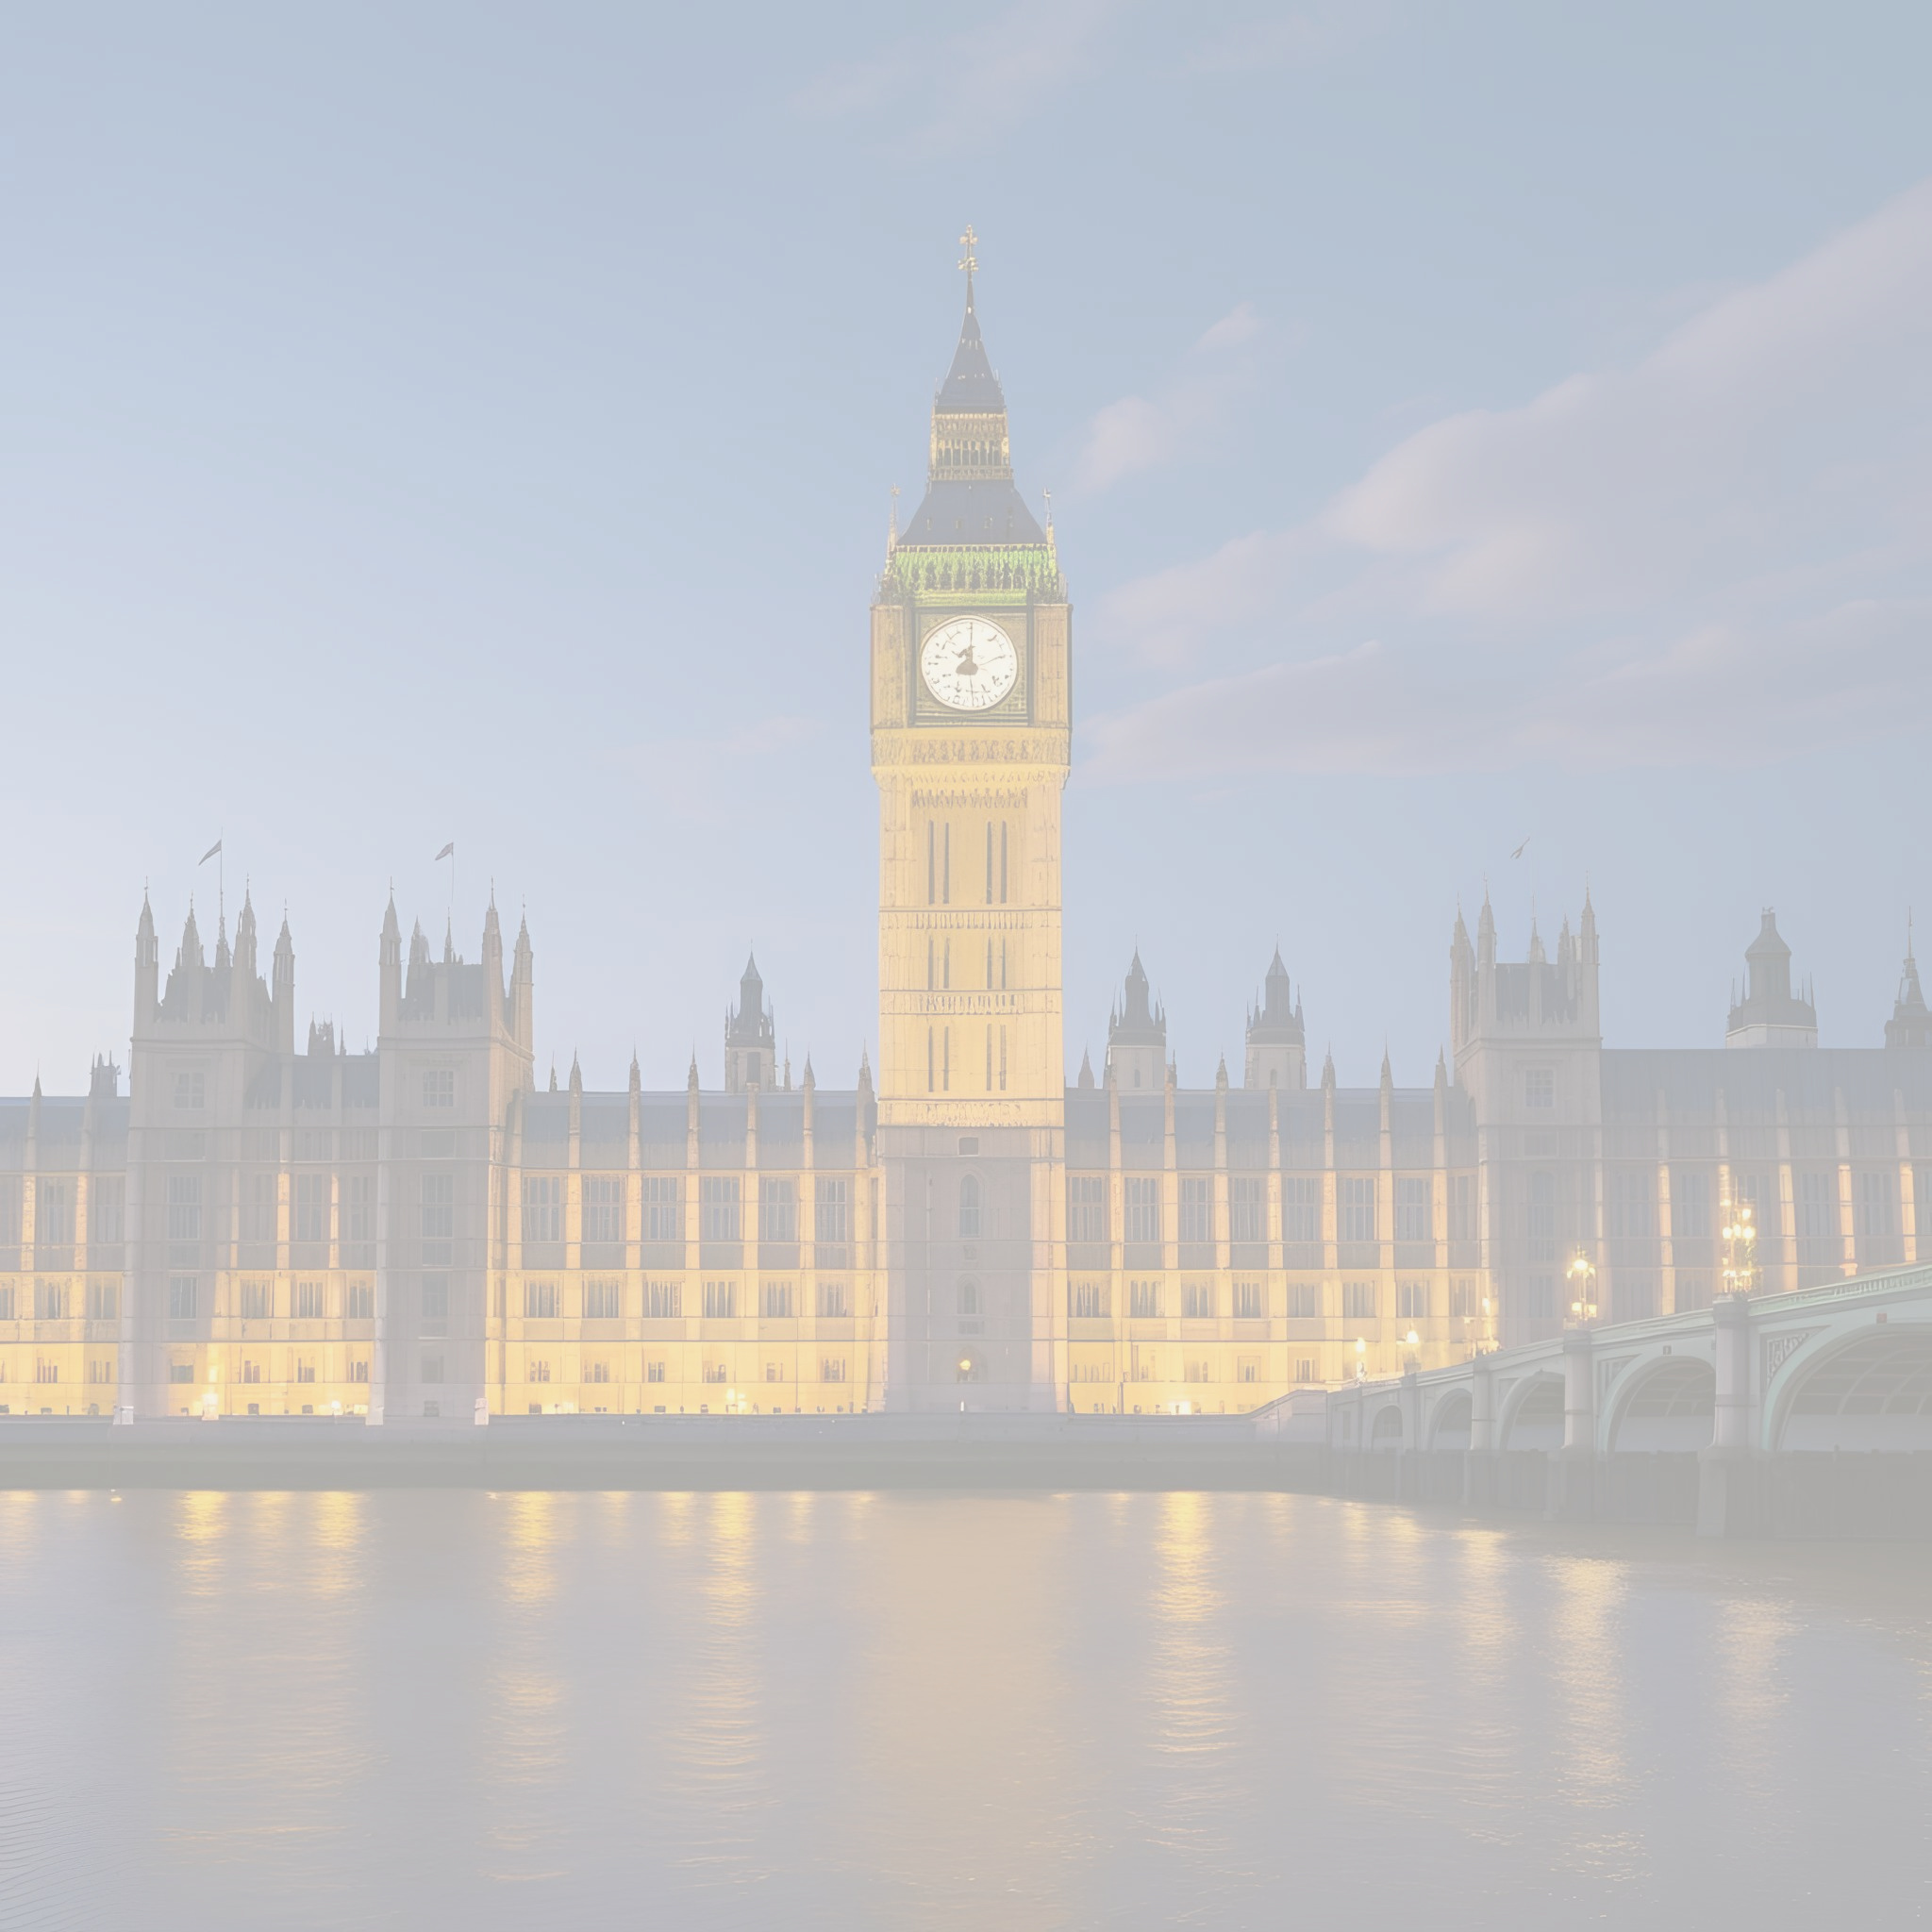


UK Parliament Week 2025
With Stephen Morgan MP

Slide 2
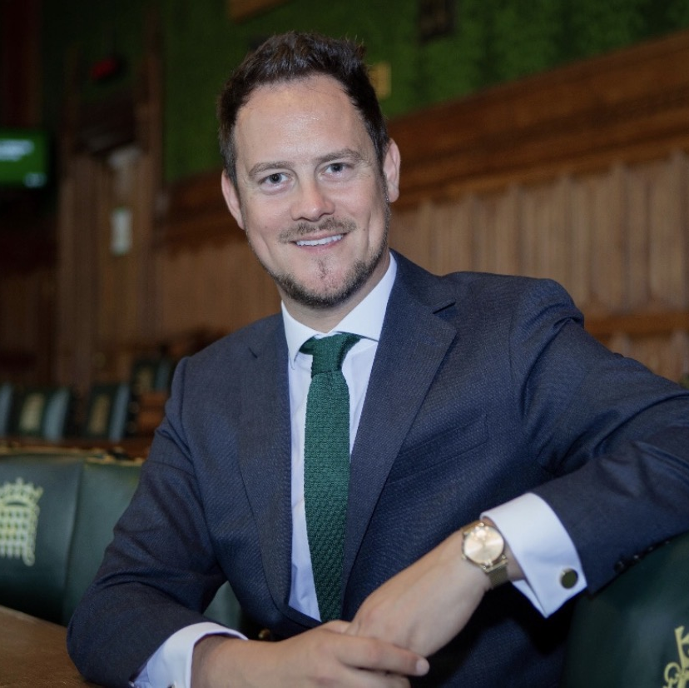
Contents
The House of Commons
The House of Lords
What does an MP do?
How does an MP get their job?
Portsmouth South and Stephen Morgan MP
Quiz

Slide 3
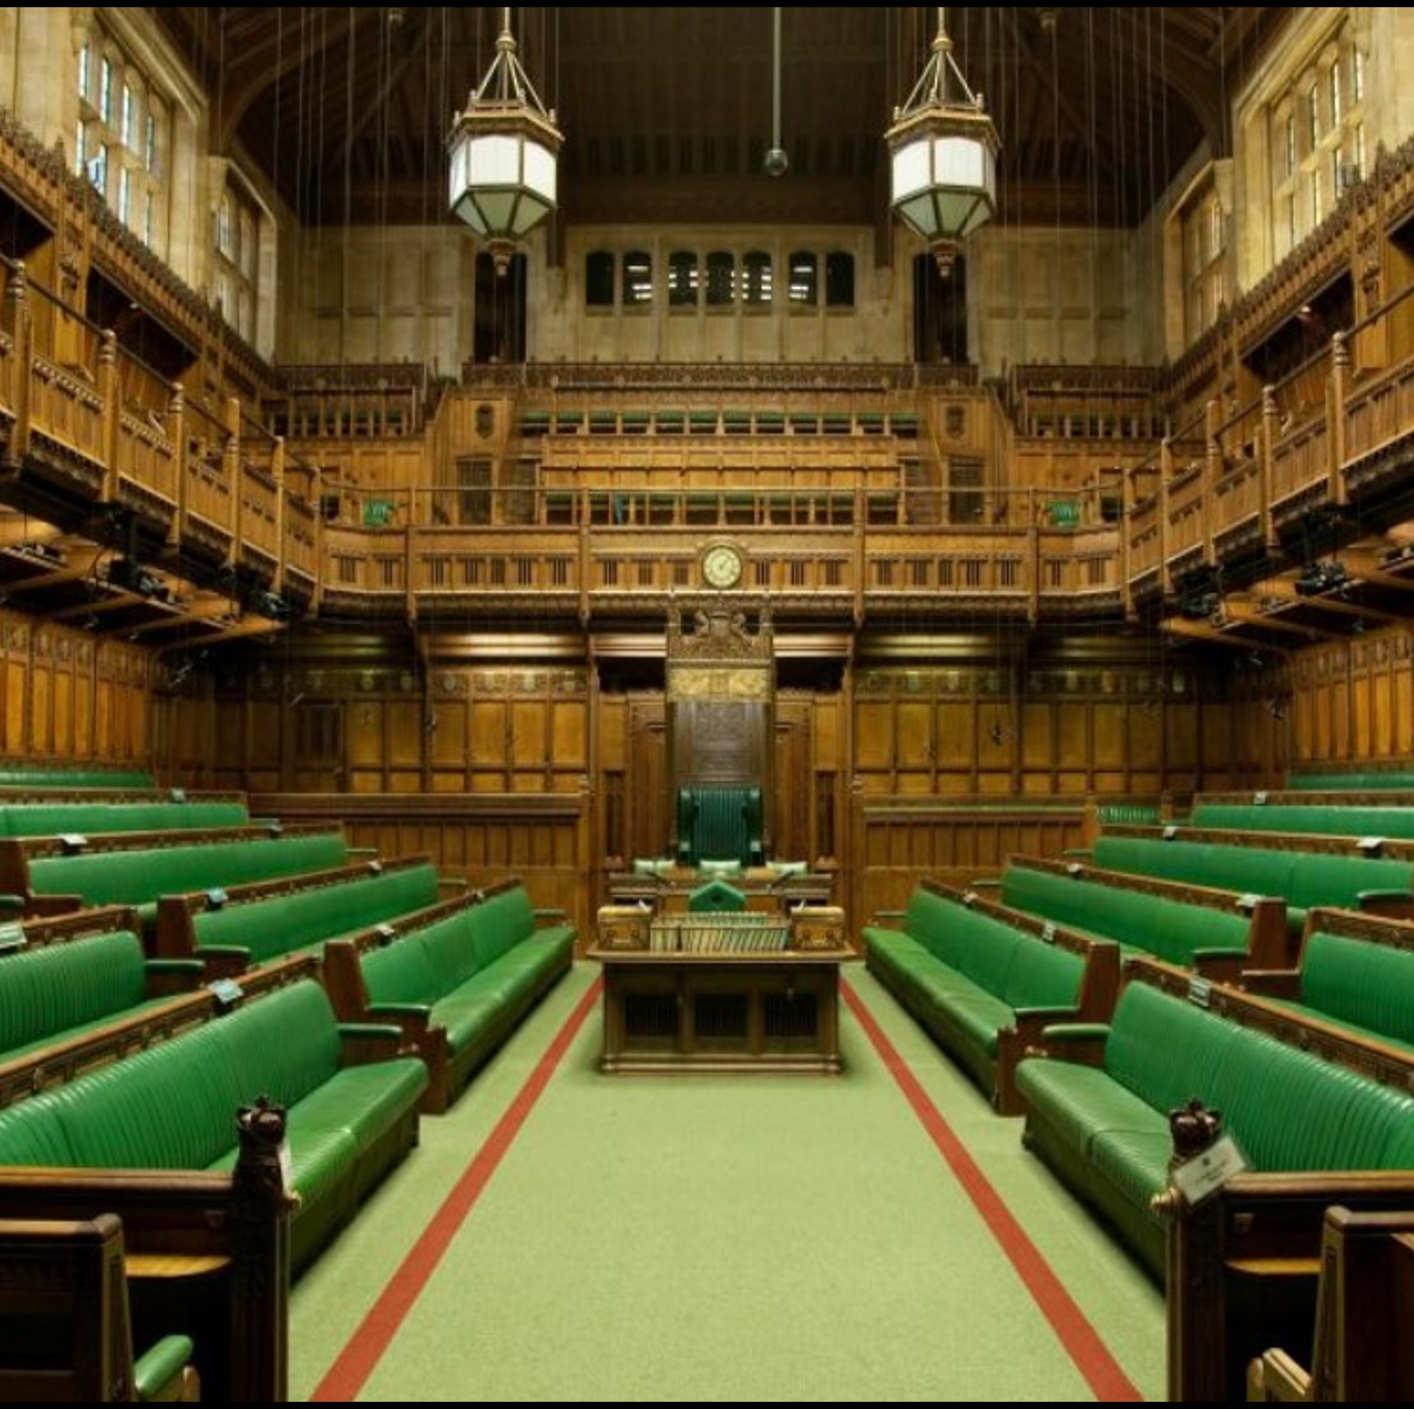
House of Commons
Members of Parliament (MPs) are elected to represent communities across the UK
There are 650 MPs, each representing a different constituency
MPs debate important national issues in the House of Commons
They propose and vote on new laws
At Prime Minister’s Questions (PMQs), MPs ask the Prime Minister about the government’s plans and decisions

Slide 4
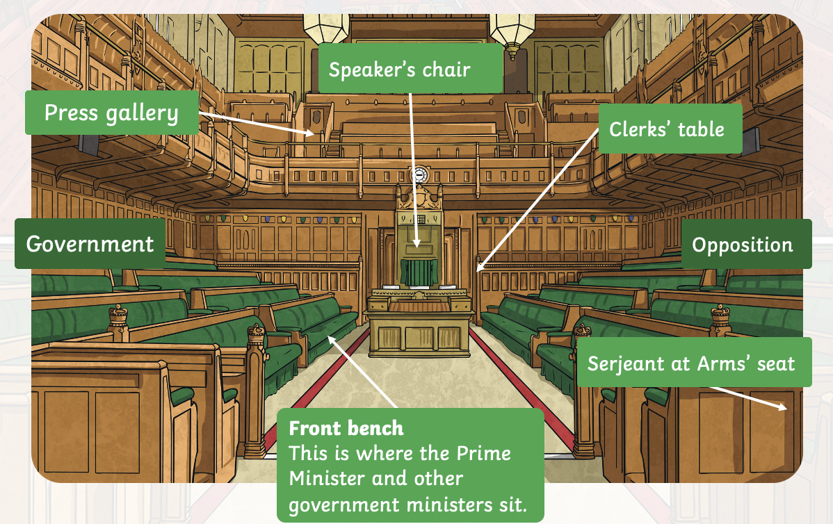
Who is in the House of Commons?
The Speaker
The Speaker is in charge of the House of Commons
They chair debates, keep order, and make sure everyone follows the rules
The Speaker must stay neutral and doesn't take sides in debates
Government benches
These seats are for MPs from the political party (or parties) in power
They sit to the right of the Speaker
The government is responsible for running the country and putting forward new laws and policies

Slide 5
Who is in the House of Commons?
Ministers
Ministers are MPs or members of the House of Lords who have specific responsibilities, like health or education
Senior ministers, such as the Prime Minister and Chancellor, sit on the front row — known as the “front bench”
Opposition benches
MPs from parties not in government sit opposite the government benches
The main opposition party also has “shadow” ministers who challenge the government’s ideas and offer alternatives
Backbenchers
Most MPs are backbenchers — they don’t hold ministerial or shadow minister roles
They represent their constituents, take part in debates, and vote on laws
Backbenchers are important for holding both the government and opposition to account.

Slide 6
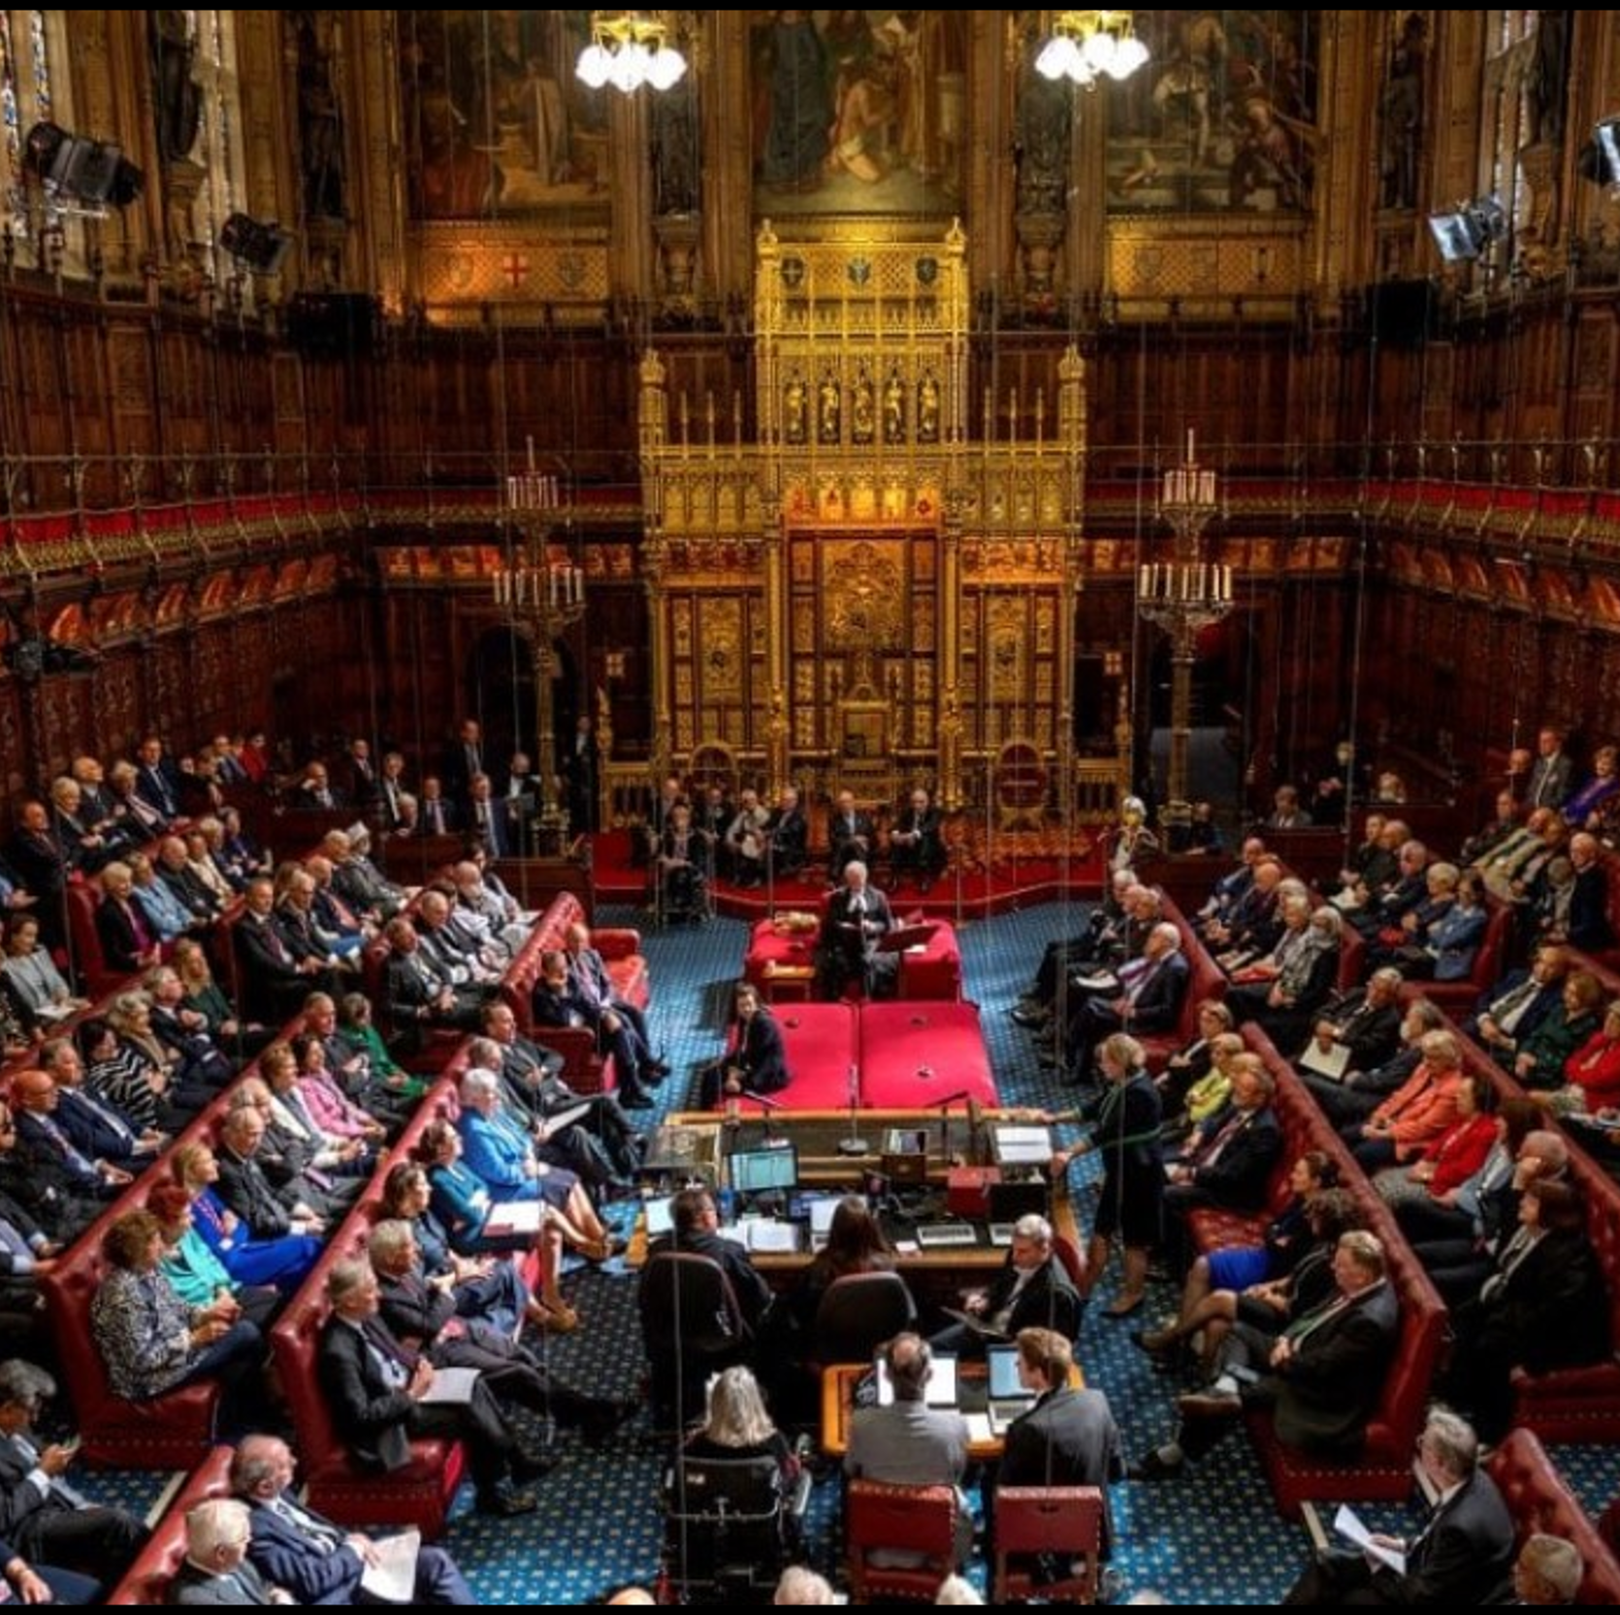
House of Lords
The House of Lords works alongside the House of Commons to help make and improve laws
Making and shaping laws
Lords review new laws passed by the Commons
They suggest changes to improve the wording or fix any problems
Checking and challenging the government
The 800 Lords hold the government to account by questioning ministers, leading inquiries, and publishing reports
Bringing expert knowledge
Many members are leaders in fields like law, science, health, education, or business
Their expertise helps shape better policies

Slide 7
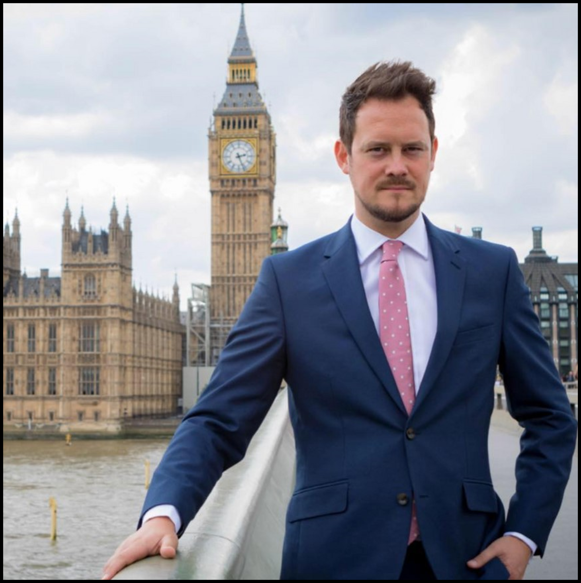
What does an MP do?
Represents the interests and concerns of the people in their constituency
Splits time between working in Parliament and their constituency
Raises issues affecting their constituents, attends debates and votes on new laws

Slide 8
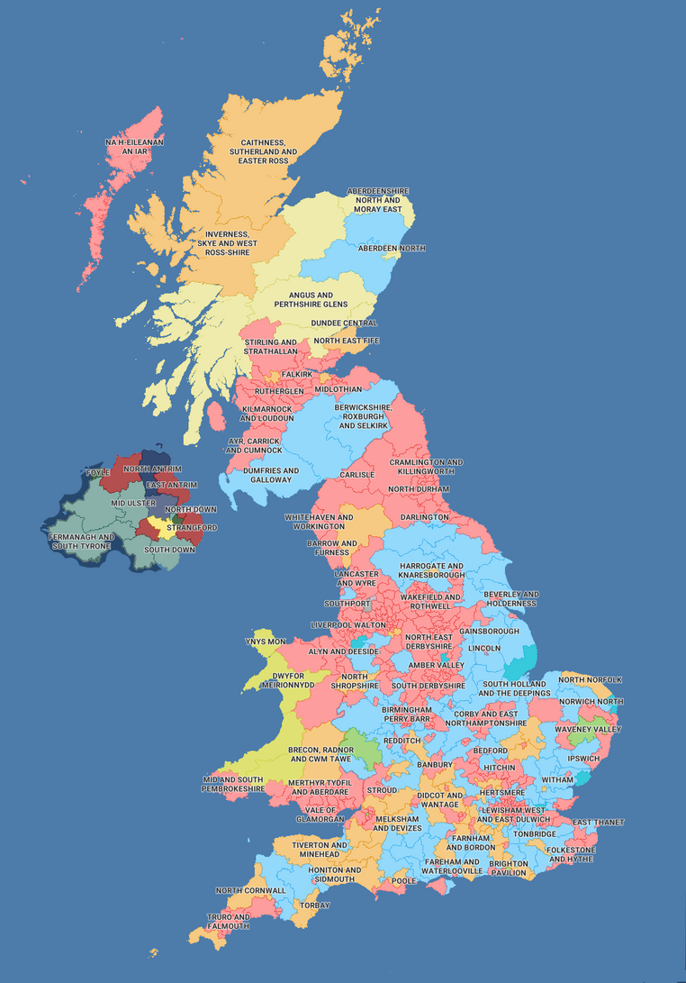
How does an MP get their job?
MPs are elected by the public during a General Election, which usually happens every five years
Each MP represents a constituency — a local area in the UK
Candidates usually belong to a political party, but some stand as independents
The person who gets the most votes in each constituency becomes the MP
The leader of the party with the most MPs is usually asked to form a government — and becomes the Prime Minister

Slide 9
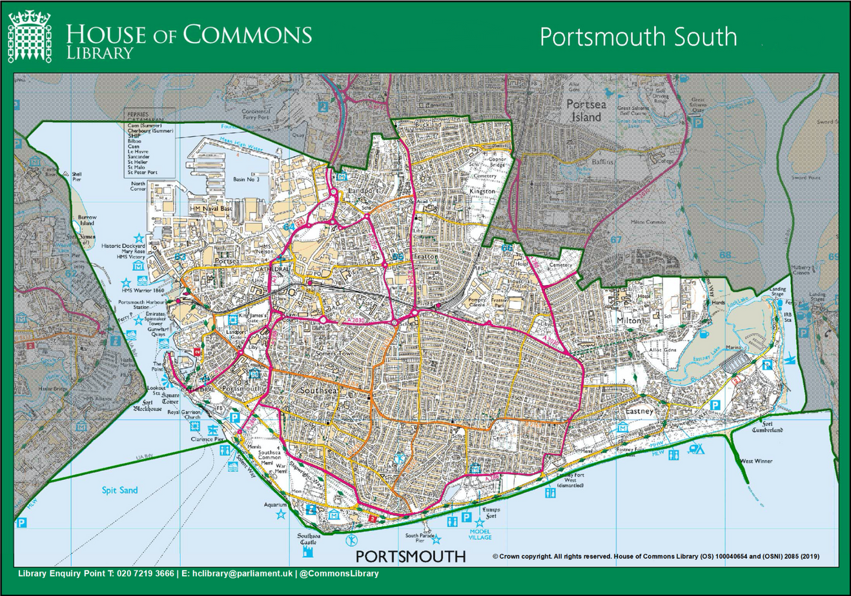
Portsmouth South
There are two constituencies in Portsmouth – Portsmouth North and Portsmouth South
Constituency population around 73,700 registered voters
Stephen receives around 17,000 emails per year from constituents
Each year Stephen, with help of his small team, help approximately 7,500 individual people with their problems
Most common topics include housing and immigration, but constituents contact Stephen about everything—from bumblebees to assisted dying
Stephen’s job is to try to represent all voices— balancing local everyday issues and national debates.

Slide 10
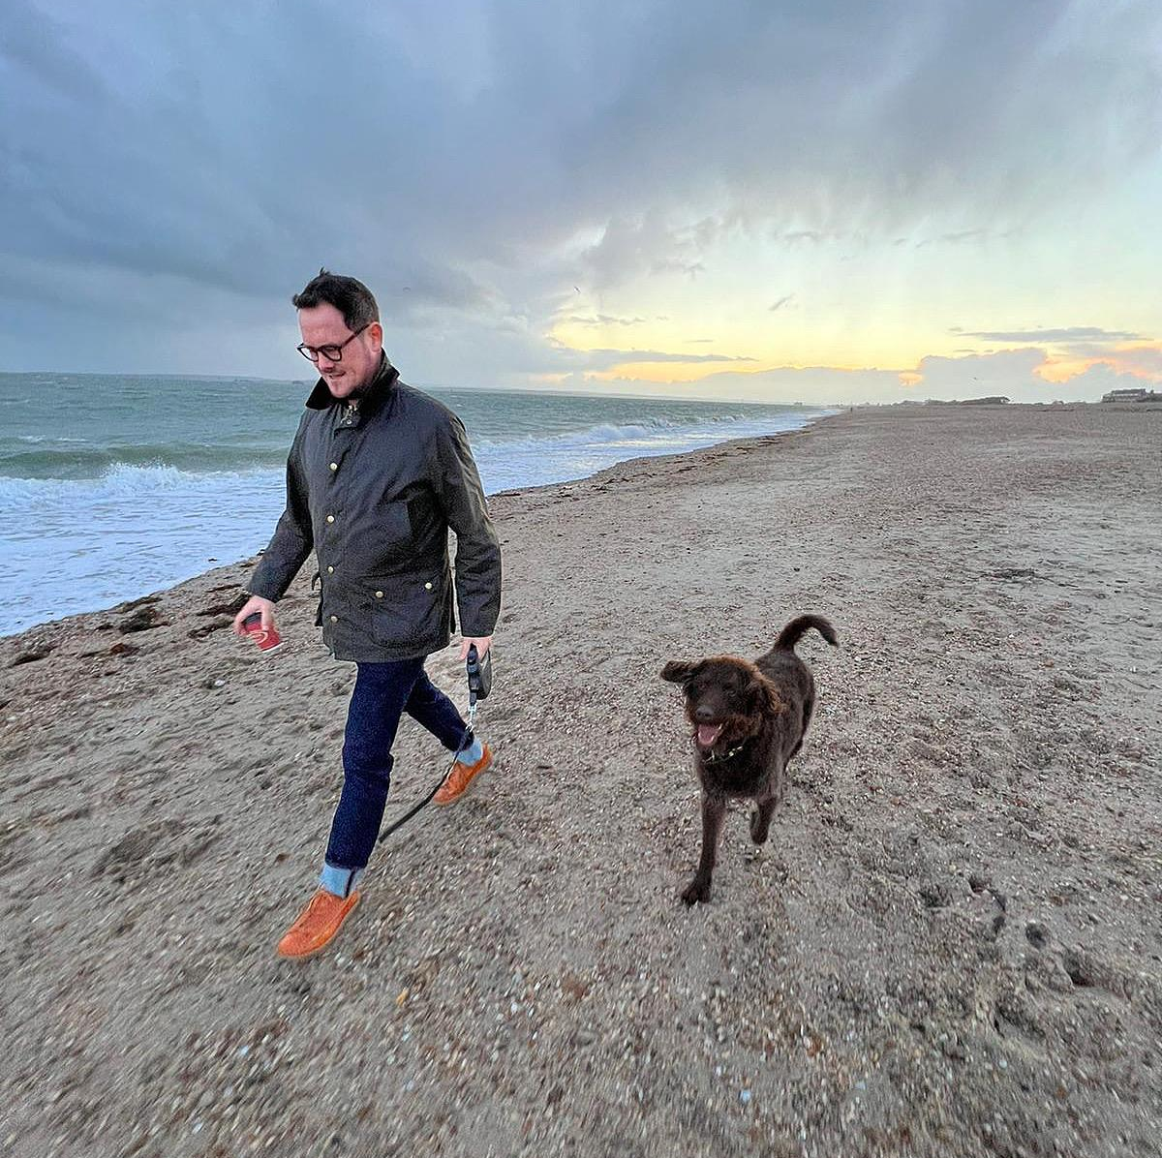
Stephen Morgan MP
Grew up in Fratton and attended local schools - Penhale Infant, Newbridge Junior, Priory School and Portsmouth College
First in his family to go to university
Worked in local government and chief executive of a charity
Elected as MP in 2017 and re-elected in 2019 and 2024
Served as Minister for Early Education from July 2024 until September 2025
Appointed in September 2025 as Lord Commissioner of the Treasury in the Government Whips' Office

Slide 11
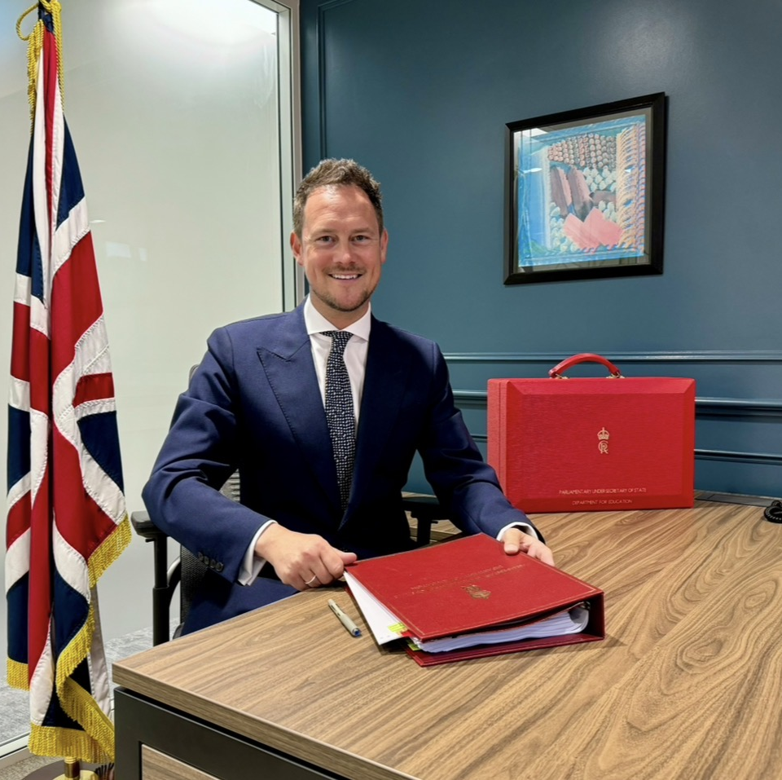
Stephen’s Priorities
Making our City’s Streets Safer
Protecting our Precious Environment
Ensuring Every Child Succeeds and Thrives
Caring for our Local NHS
Securing the Investment our Community Deserves

Slide 12
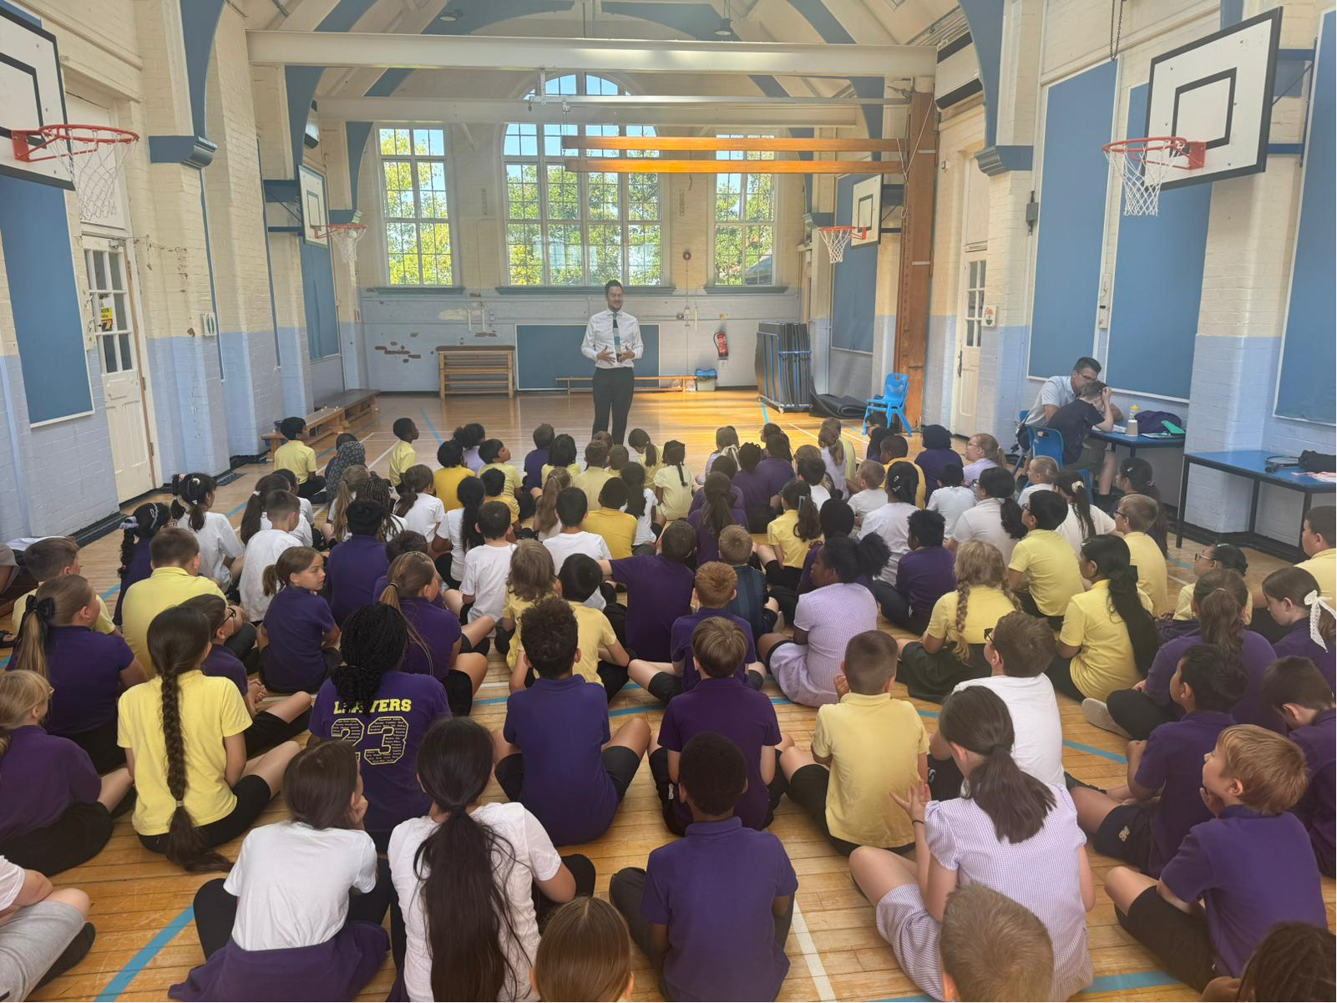
Quiz Time

Slide 13
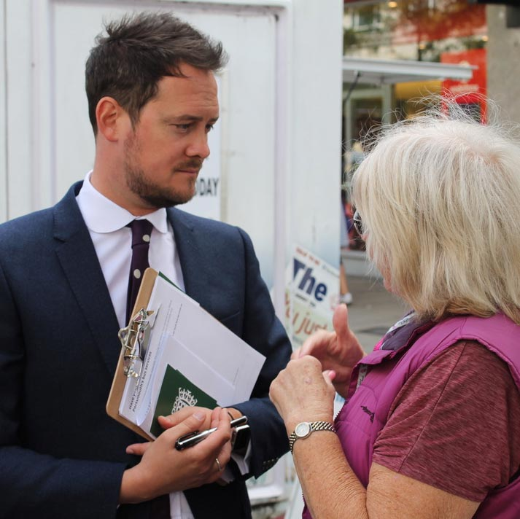
Question 1:
How does someone become an MP?

Slide 14
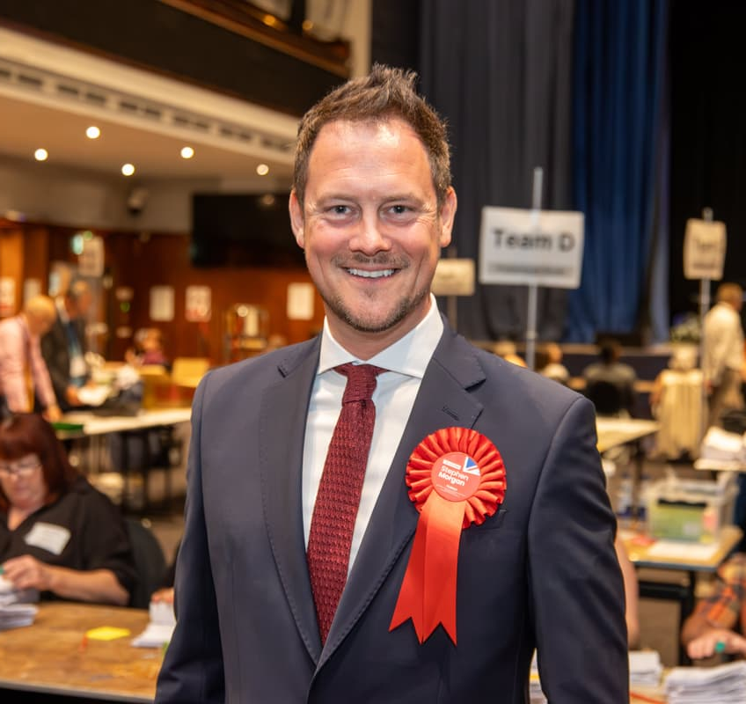
Answer 1:
They are elected by voters in an Election

Slide 15
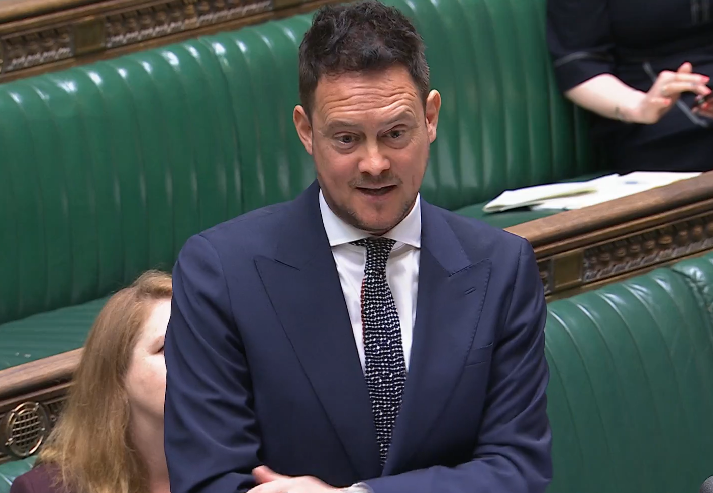
Question 2
True or False: There are not enough seats for all MPs in the House of Commons

Slide 16
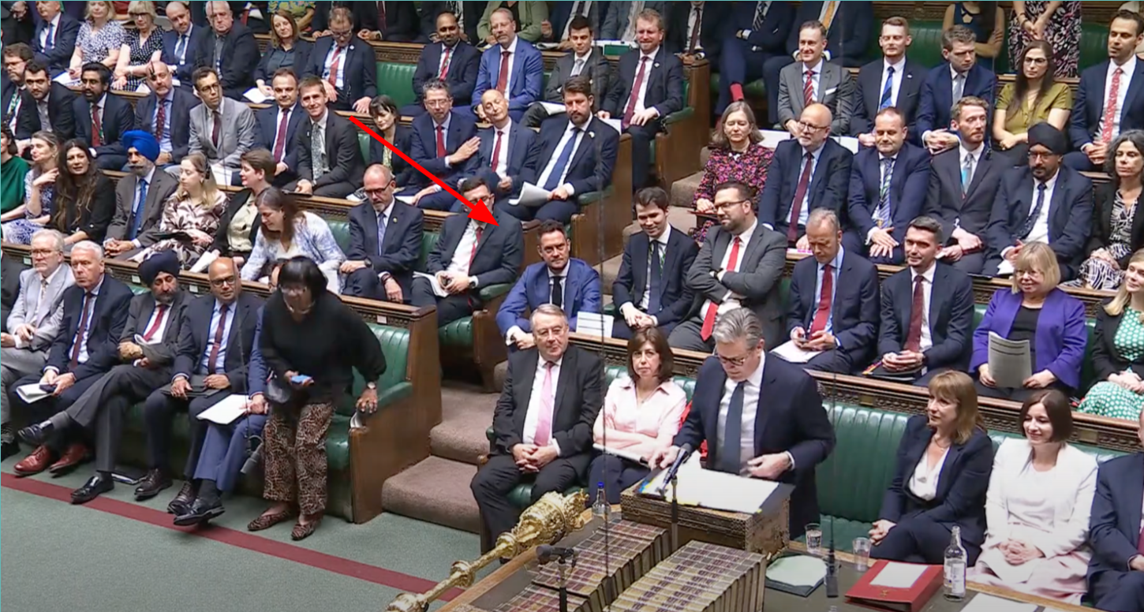
Answer 2: True!
There are not enough seats for all MPs in the House of Commons
There are 427 seats in the House of Commons and there are 650 MPs

Slide 17
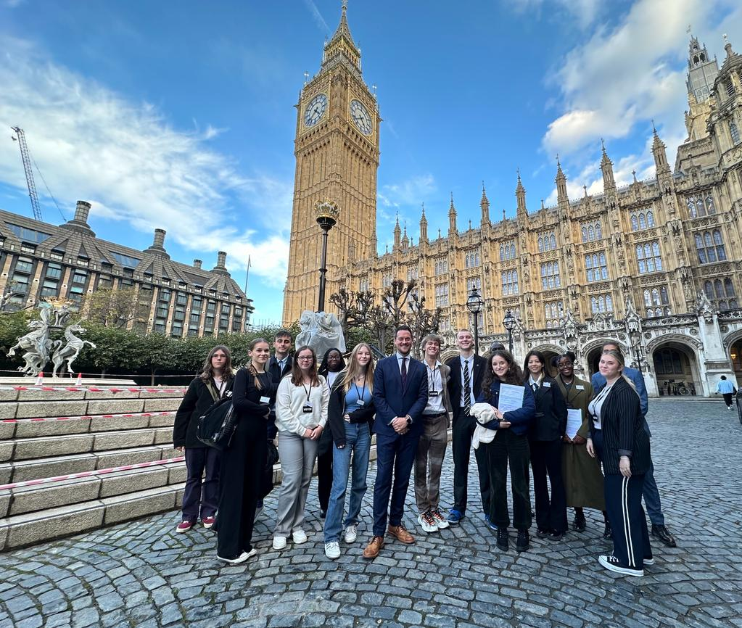
Question 3:
How many countries are represented in the House of Commons?

Slide 18
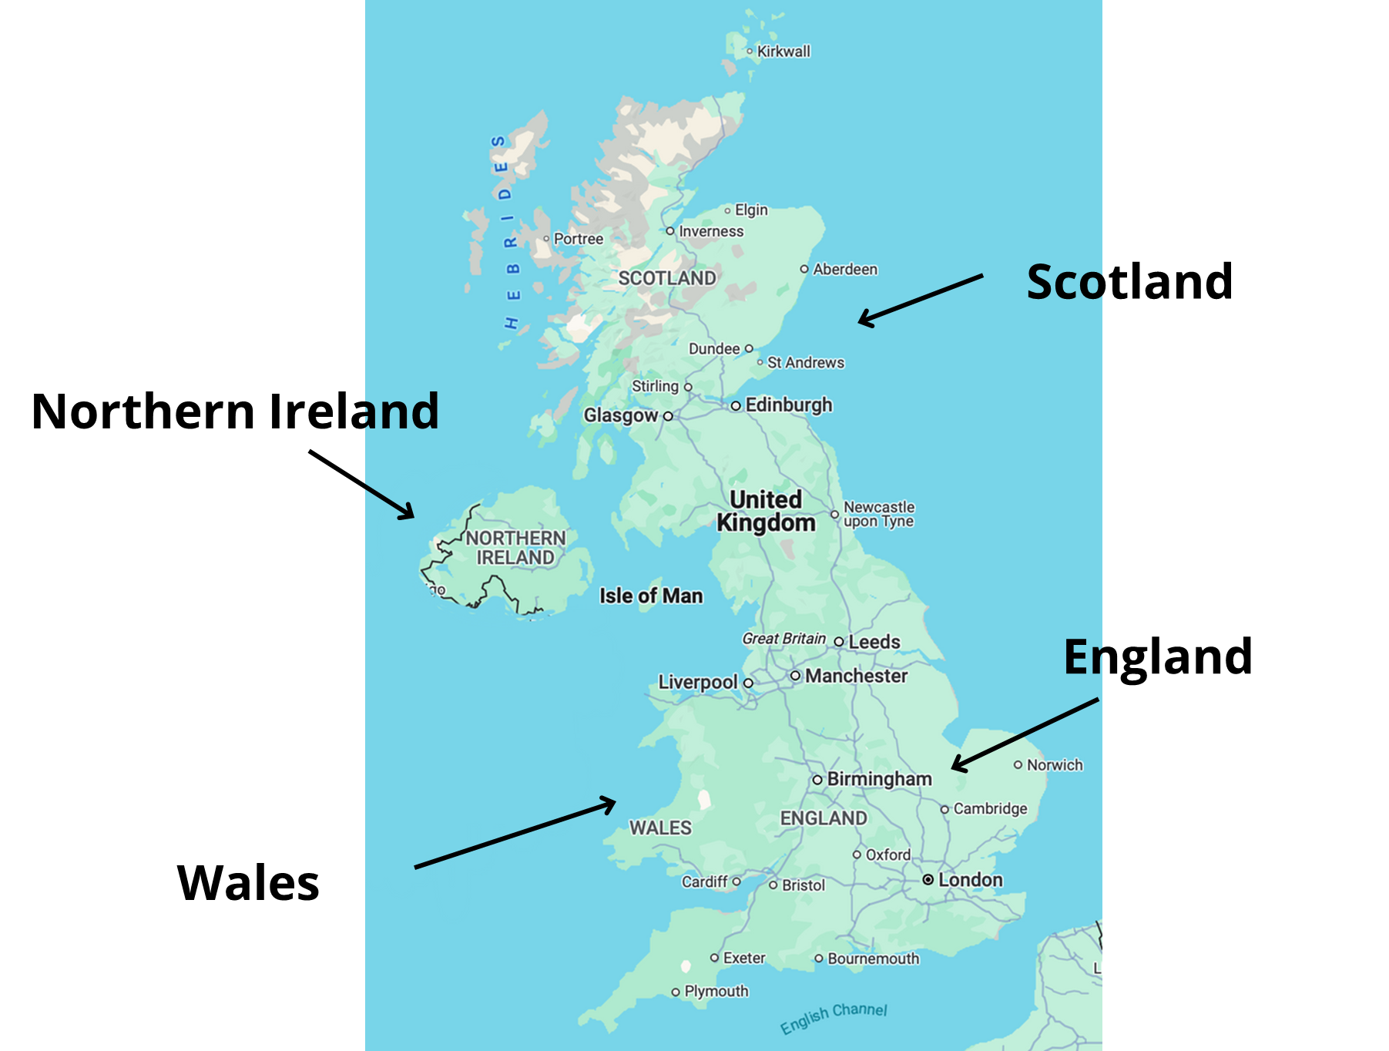
Answer 3:
Four countries are represented in the House of Commons

Slide 19
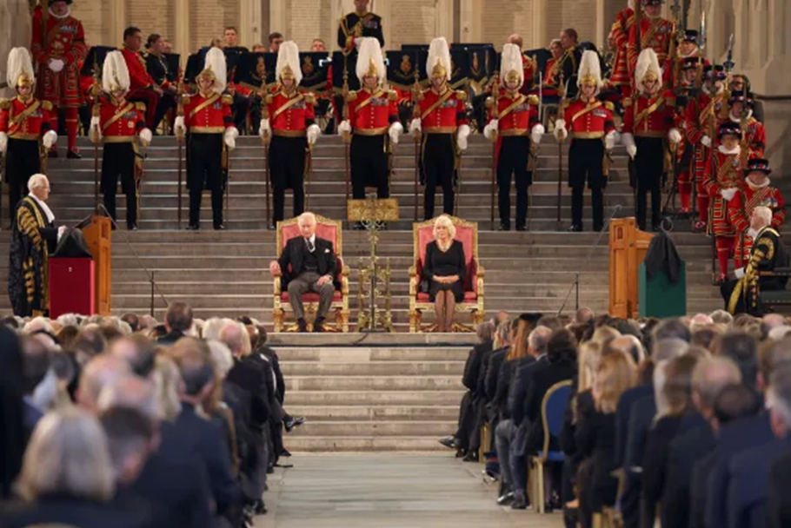
Question 4
True or False:
The King is allowed into the House of Commons

Slide 20
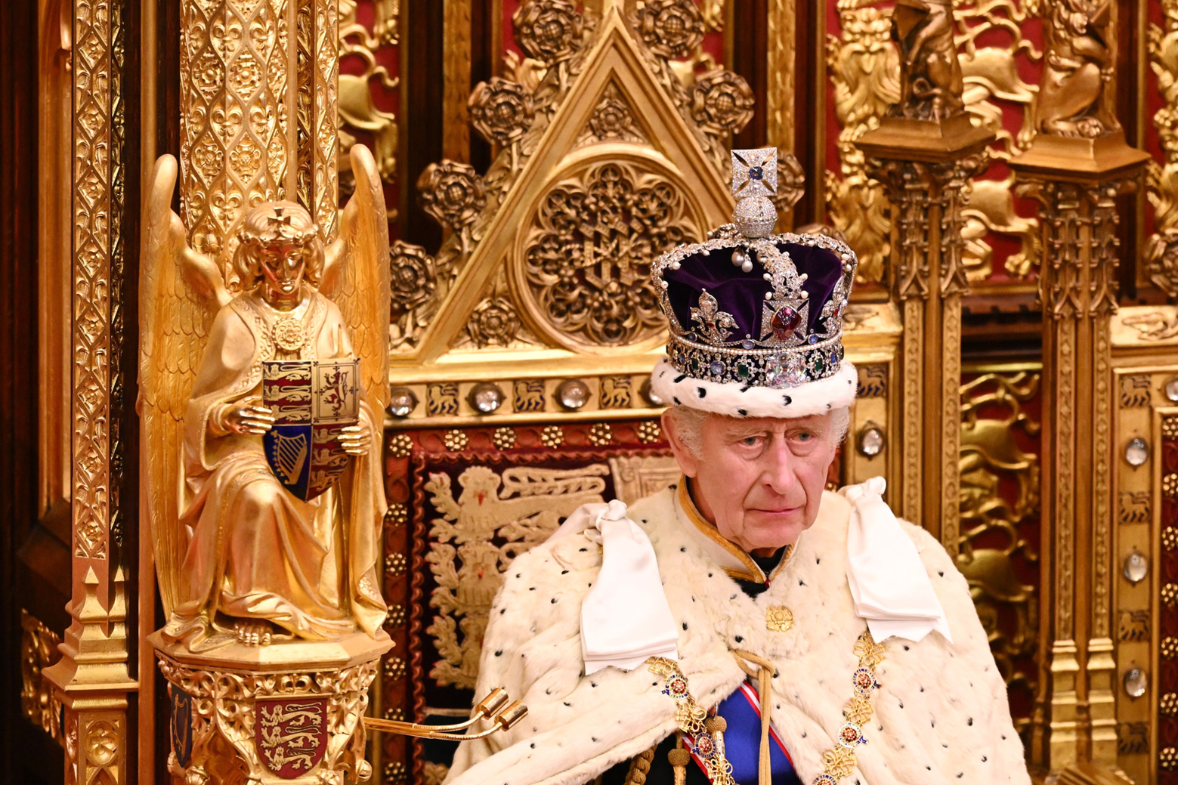
Answer 4: False!
The King is not allowed into the House of Commons
This tradition began in 1642, when King Charles I entered the Commons with soldiers to arrest five MPs
Since then, no monarch has set foot in the Commons — to show that Parliament is independent from the Crown
That’s why the King’s Speech is always delivered from the House of Lords, not the Commons

Slide 21
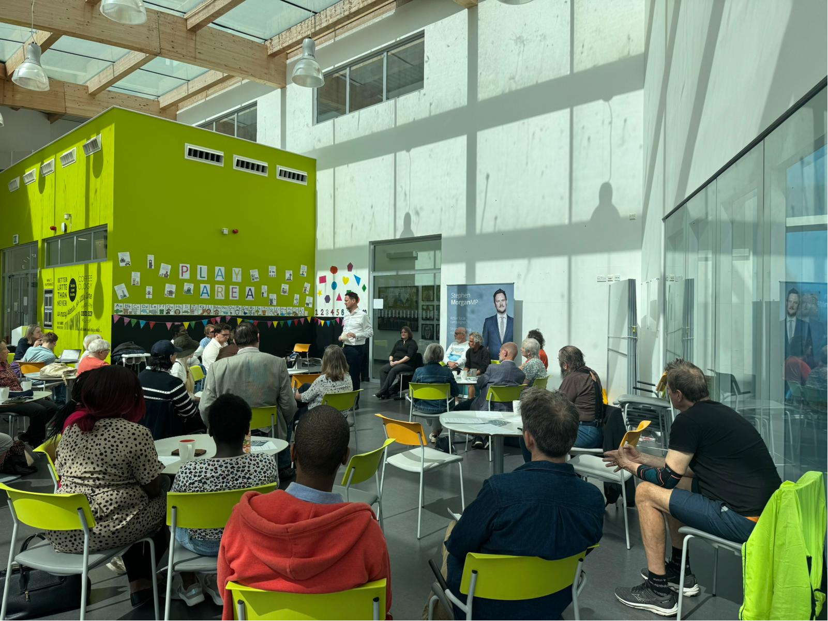
Question 5
How can I contact my MP?

Slide 22
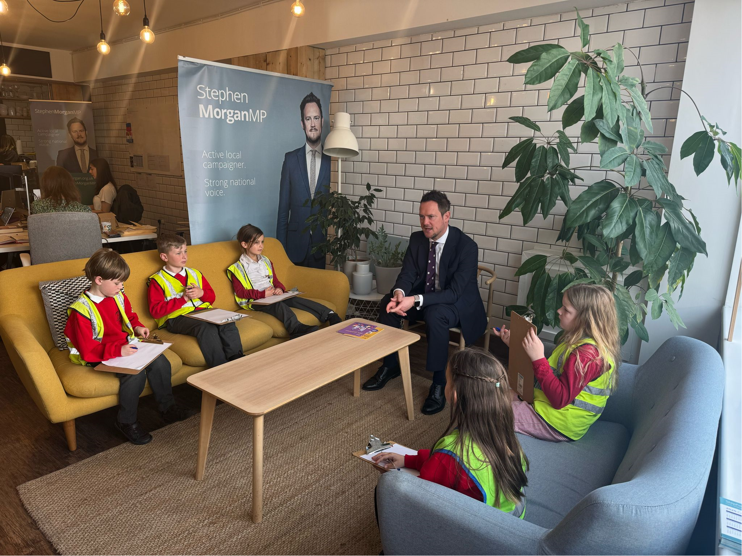
Answer 5
You can get in touch with the MP for your area by email, letter, phone, dropping into their constituency office or by attending a local event.
It is important to include your full name and postcode in any correspondence as MPs can only help their own constituents
If you live in Portsmouth South and want to share your thoughts, issues or concerns please get in touch with Stephen

Slide 23
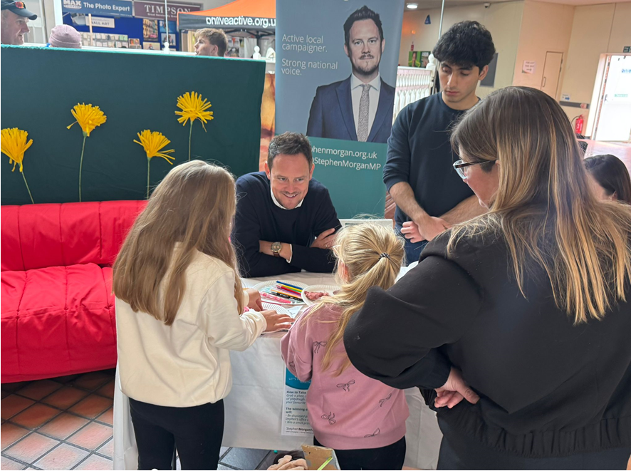
Website: www.stephenmorgan.org.uk
Email: Stephen.morgan.mp@parliament.uk

